Slide 1
Bank Management System
Software Quality Assurance

Slide 2
Course Code: CSE 435
Course Title: Software Quality Assurance
Submitted to
Toukir Ahammed
Lecturer,
Dept. of CSE
East West University

Slide 3
Group Members
Name | ID
Adnan Saif | 2018-1-60-157
Md. Mahmudur Rahman Limon | 2018-1-60-253
Fatima Tanjum Tuba | 2018-1-60-049

Slide 4
Introduction
Bank Management System:
This is a web based system, created for managing the internal activities of the bank. For that, several functionalities were introduced, such as:
Creating Profiles for Manager, Employee and Customer
Updating Such Profiles
Removing Profiles
Handling transactions and more.
Here we will analyse the test cases of those functions.

Slide 5
Test Planning
The goal is to test the features of the software to determine the efficiency, correctness, and effectiveness. For that, we have designed test cases. we have mainly focused testing plans and procedures of the requirement specification of the system. But we did not conduct testing procedures on design specification, database, and security of the software as it was out first time testing the software. The features that we have tested are:
Sign Up
Sign In
Create Employee ID
Remove Employee ID
Update Profile
Create Customer ID
Remove Customer ID
Transfer
Deposit
Withdraw

Slide 6
Test Planning
Pass/Fail Criteria
Sign In/ Sign Up function: Valid information has to be given in order to pass, otherwise failure.
Creating and Removing Employee ID: Must be from manager profile and must be filled all the fields with proper information
Create and Remove Customer ID: Valid information must be given. Otherwise it will result in failure.
Transfer/ Deposit/Withdraw: Proper Account information and transaction amount must be given otherwise it will fail.

Slide 7
Responsibilities and Schedule
Responsibilities: All the plans and strategies were made by us. We worked together as a unit to complete the project.
Schedule: A schedule was created for us to follow and complete the project.
Task | Test Design and planning | Sign up/ Sign in | Creating Customer/Employee ID, Removing Customer/Employee ID and Update Profile | Deposit, Transfer, Withdraw | Reviewing All the Completed Tasks
Day | 0 | 1-4 | 5-10 | 11-14 | 15-16

Slide 8
Planning Risks and Contingencies
Contingency Plans
Decrease the number of test cases
Expand schedule.

Slide 9
Test Case Design
We have designed the test cases using “Black Box” testing method. In a “Black Box” testing method, the features and functionalities of a software is tested without having any generalized idea of the source code, coding structure, implementation or internal path. For that we chose Boundary Value Checking. It is a type of “Black Box” testing method in which, the test cases are designed to include representations of bounded values ​​in a range. The attributes of Boundary Value Checking are:
It generates test cases for each of the function’s input specification.
For every numerical variable in the input specification, a set of minimum values, minimum+ values, maximum values and maximum- values and nominal values are calculated.
Based on the number of variables in input specifications (n), the total number of test cases are calculated; that is 4n + 1.
Depending on the input values, a set of expected outputs are generated through brief calculation.This was done for every test case item.

Slide 10
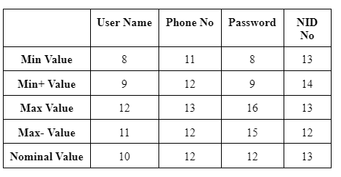
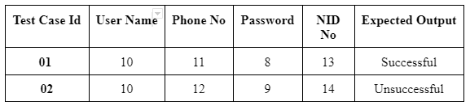
Test Case Design (cont.)
Example: “Sign-Up” function: The selected variables of this test case for BVC calculation are: “username”, “phone”, “password” and “NID”. The number of total test cases will be 4n + 1 = 17. First 2 of the total 17 test cases are given below.

Slide 11
Execution and Evaluation of the Result
We have used Test Incident Report Identifier and Test Incident Summary Identifier to execute and evaluate the result. Execution and Evaluation of the result consists of:
Execution of each functions
Detecting Anomalies
Identifying the status of a function after execution
Evaluating the state of a function

Slide 12
Test Incident Report Identifier
It takes valid and invalid inputs from a function and shows expected outputs, actual outputs and detected anomalies.
If the expected output matches with the actual output it shows no anomalies.
Anomalies are detected when the expected output does not match with the actual output.
Each incident can be attempted to repeat multiple times.

Slide 13
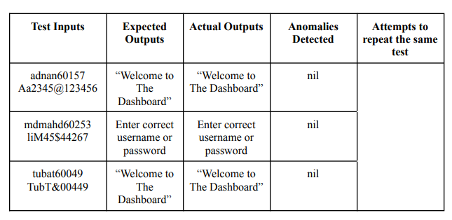
Test Incident Report Identifier (Cont.)
Example: TIR 02

Slide 14
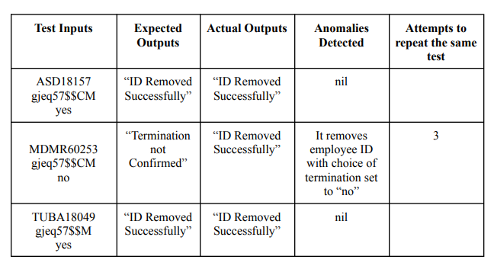
Test Incident Report Identifier (Cont.)
Example: TIR 04

Slide 15

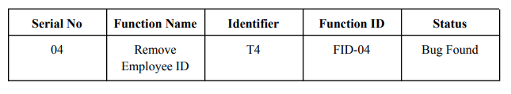
Test Summary Report Identifier
In Test Summary Report Identifier summary of the each test incident is identified.
Example:
TS2
TS4

Slide 16
Conclusion
We have analyzed the test cases for a web based software, Bank Management System. Where we have created test cases based on the pass/fail criteria of each features of the software. We have designed the test cases using Boundary Value Method of Black Box testing. We have executed and evaluated the results using Test Incident Report Identifier and Test Summary Report Identifier. We have found some bugs in that process. In future test case analysis our goal will be to reduce those bugs, so that we can have a efficient and effective software.

Slide 17
THANK YOU

